Slide 1

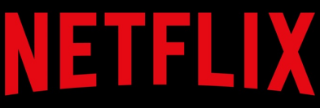
Strategic Insights for CS-Streaming: Learning from Netflix
Wild booleans

Slide 2
An Introduction
type | title | director | cast | country | date_added | release_year | rating | duration | listed_in | description
Launched on January 16, 2007, nearly a decade since Netflix began its pioneering online movie rental service.
Netflix is the most-subscribed streaming media service, with 238.39 million paid memberships in more than 190 countries.

Slide 3
Setting the Scene for CS-Streaming's Strategy
type | title | director | cast | country | date_added | release_year | rating | duration | listed_in | description
Purpose:
Leveraging Netflix data to shape CS-Streaming's content strategy.
Objectives:
Identify key content trends.
Understand viewer preferences.
Guide strategic decision-making.
Significance:
Insights from a market leader offer a blueprint for success.
Data-driven approach for competitive positioning.

Slide 4
Refining Data for Accurate Insights
type | title | director | cast | country | date_added | release_year | rating | duration | listed_in | description
Cleaning Steps:
Standardize names for consistency.
Filled missing values, remove duplicates
Data Transformation:
Converted data to appropriate format.
Extracted ‘added_year’ and ‘added_month’ from ‘date_added’.
Outlier Handling:
Removed extreme values in ‘duration’ and ‘release_year’ for focused analysis.
Data Segmentation:
Separated dataset into two categories: Movies and TV Shows.
Enables targeted analysis for each content type.

Slide 5
VISUALS

Slide 6
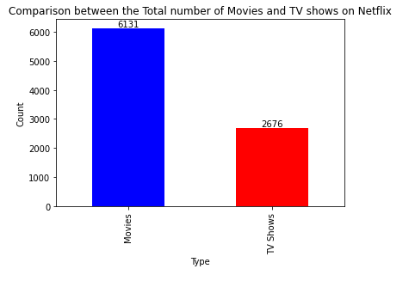
Notes:
We have done a series of visualisations to gain some insights from the data and explore different ideas for our streaming company.
Nikul: This bar graph is showing a count between the Total Number of Movies and TV shows on Netflix. There are 6131 Movies which is 69.6% of the total number of movies and TV shows in comparison to 2676 TV shows which is 30.4%. One initial thought from seeing these figures is that our streaming company could potentially look to target the 30.4% and increase this percentage by potentially introduce more TV shows to our own platform to rival Netflix.

Slide 7
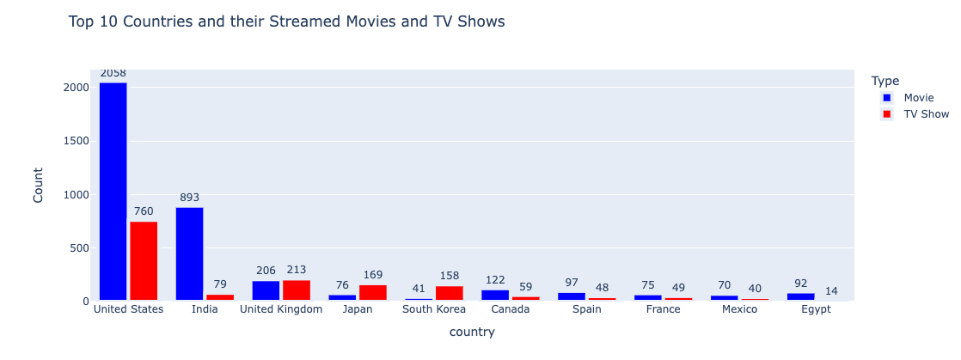
Notes:
Nikul: This bar graph shows the Top 10 countries and their streamed movies and TV shows. From this you can decipher that the United States and India watch more movies than TV shows and also have a higher amount of movies and TV shows on Netflix. For our company I feel that we can look at increasing the amount of Movies and TV shows from certain countries such as Japan, South Korea, Canada, Spain, France, Mexico and Egypt as this could potentially attract a larger audience from these countries.

Slide 8
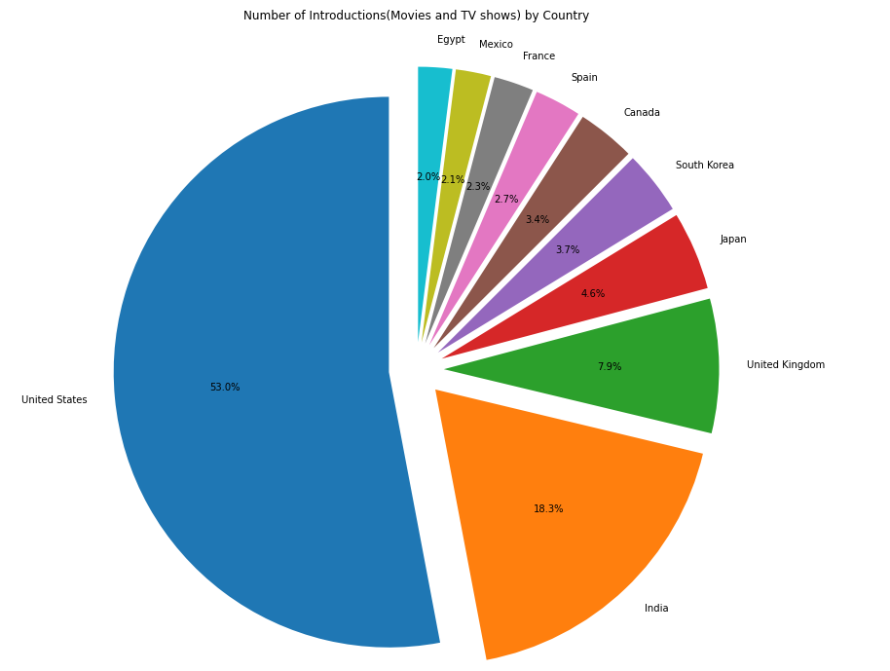
The US, where Netflix was born, is the biggest contributor to the titles on Netflix, followed by India and the UK.
Notes:
Nikul: This pie chart depicts the total number of TV shows and Movies by the Top 10 countries as a percentage. The US where Netflix was born is the biggest contributor to the titles on Netflix with 53% followed by India and the UK. A potential avenue we can explore is that our streaming company should look to target the 20.8% of countries which exclude US, India and United Kingdom as these countries have potential to provide our company with more of their TV shows and Movies to allow us to showcase variety in our streaming service in comparison to what Netflix already provides from the US, India and UK.

Slide 9
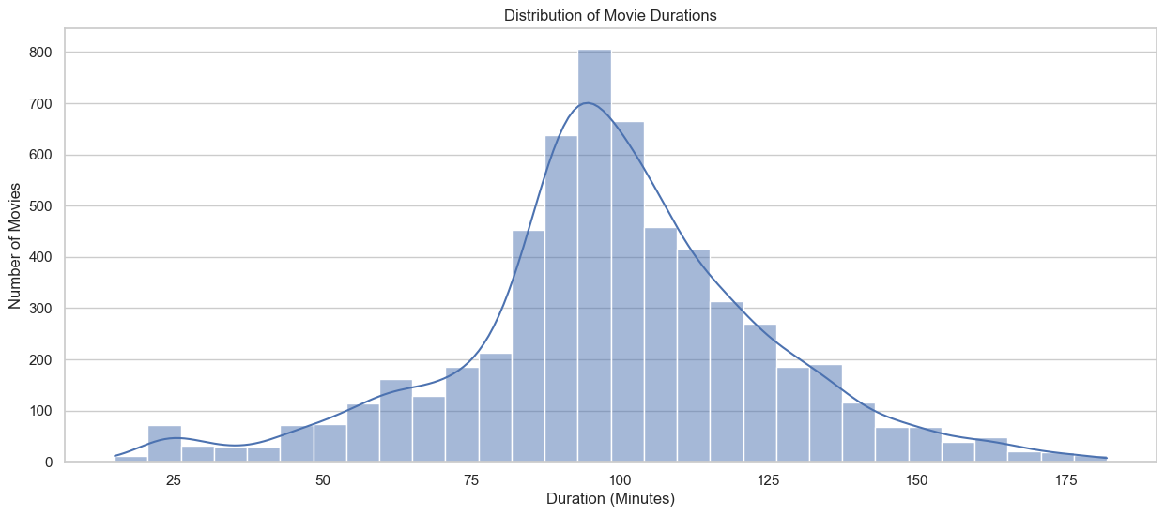
Notes:
RAHUL
This graph illustrates the distribution of movie durations on Netflix. The predominant trend indicates a higher concentration of movies falling within the 80-120 minute range. On average, movies tend to align with this duration.This could be an indication for CS streaming to focus on adding movies that fall within this time length. We can infer that viewers attention span fall within this time length. However, Additional data, including view counts and viewer retention, would provide more insight into why Netflix exactly features a substantial number of movies within this timeframe. This information could potentially reveal correlations with popularity and offer a more accurate understanding of Netflix's content strategy.

Slide 10
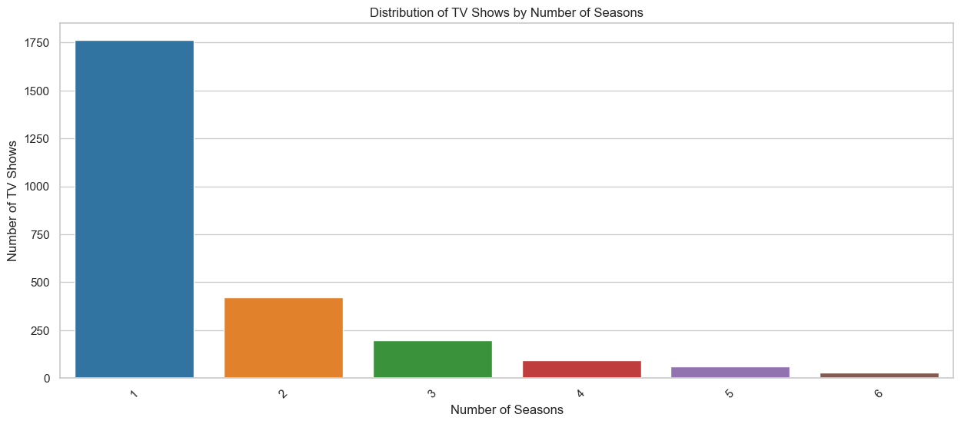
High number of single-season TV shows.
Longer series indicate successful engagement.
Strategy to include shows with more than two seasons.
Notes:
RAHUL
The distribution graph for tv shows by number of season clearly shows that there are a high number of single season tv shows. but those with more than two seasons could indicate a strong following. We can't fully say that all the shows with one season have been discontinued but we would need more data to determine this. Focusing on tv shows with 2 seasons could be a sweet spot for CS-Streaming, offering shows that viewers are committed to.

Slide 11
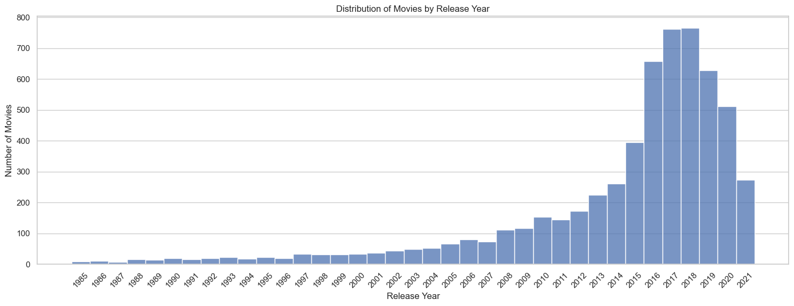
Movies Release Trends Through Time
Sharp increase in movies starting early 2010s.
Peak production around 2018.
Suggests audience demand for recent films.
Notes:
Let's dive into the trends we see in movie releases over the years. The graph shows a substantial ramp-up of movie production starting in the early 2000s, peaking around 2018. This suggests there's a rich pool of recent movies that have captivated audiences, and these could be just the kind of films CS-Streaming might want to showcase.

Slide 12
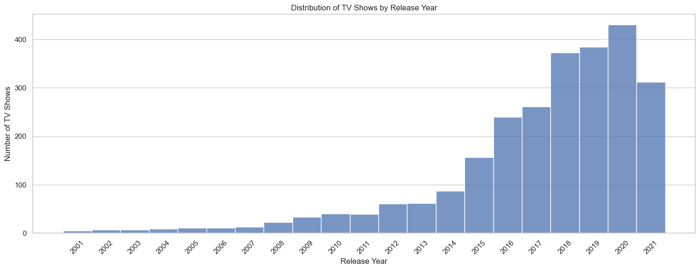
TV Show Releases Trends Through Time
Noticeable rise in TV shows from 2015, peaking in 2020
Indicates growing popularity of series.
Points to sourcing recent, engaging series.
Notes:
There's been a steady climb in the number of TV shows being released, particularly from 2015. It looks like there's an increasing demand for series, which is something CS-Streaming can tap into.

Slide 13
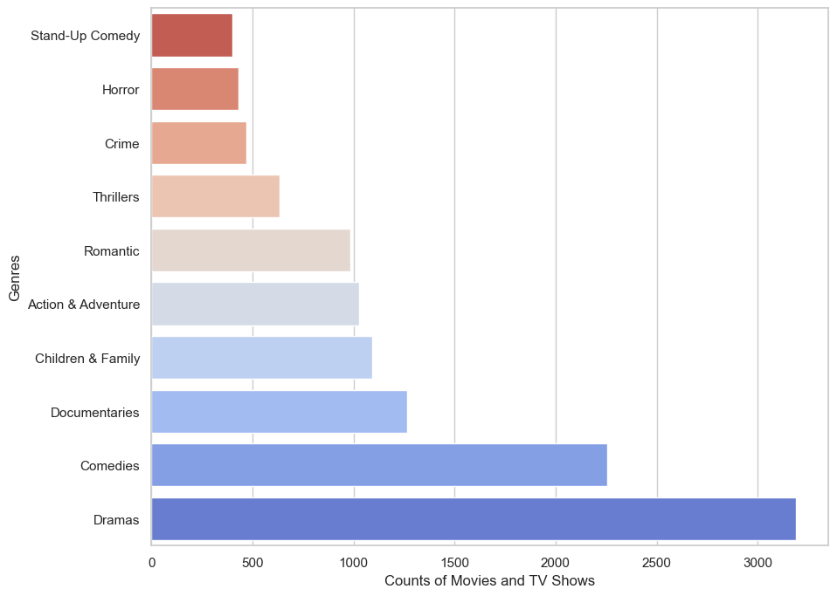
Notes:
Nikul: This bar graph shows the all the counts of Genres of Movies and TV shows on Netflix. Judging by the numbers shown, our streaming company could potentially look to target the lower count genres which are just below 500 such as Stand up Comedy, Horror, Crime, Thrillers in terms of Genres for both TV shows and Movies. If our streaming service does decide to include the popular genres then we could look at rivalling Netflix with cheaper monthly subscriptions when there is a lower season for audiences and charge higher prices which are still cheaper than Netflix during a high/peak season of streaming.

Slide 14
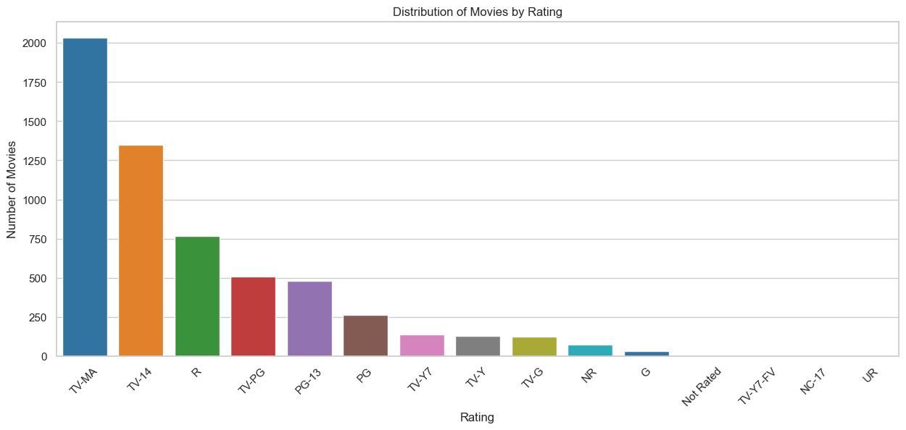
Movies Analysis – Rating Distribution
Dominance of TV-MA and TV-14 rated movies.
Reflects viewer preference for mature content.
Guides content curation for a mature audience.
Notes:
Moving on to movie ratings, there's a clear preference here. Movies rated TV-MA and TV-14 are the most common. It seems that movies with mature themes are what people are really gravitating towards. Netflix do provide movies geared towards children and young families which show that they do cater to a wider audience. This is something to keep in mind.

Slide 15
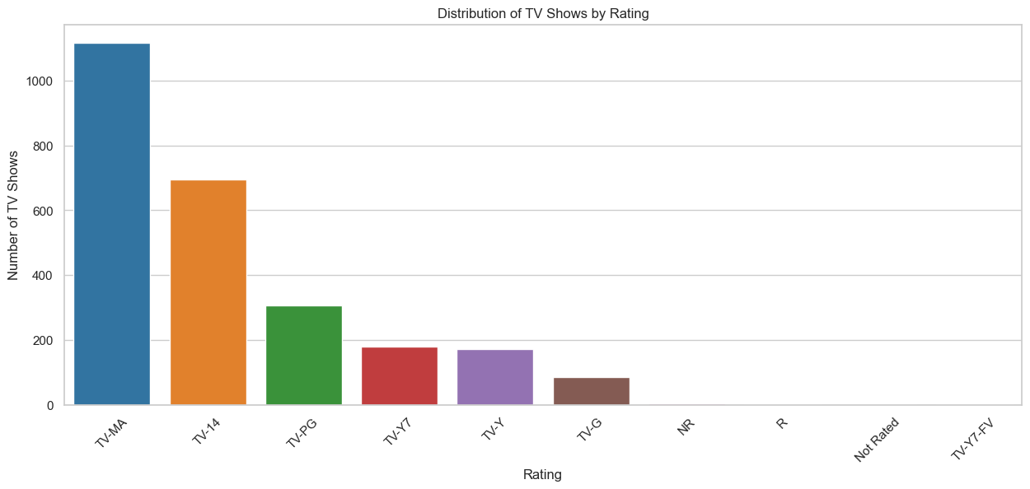
TV Shows Analysis – Rating Distribution
TV-MA and TV-14 ratings lead for TV shows as well.
Reinforces Netflix mature content strategy for TV shows.
Suggests serialized storytelling for a mature audience.
Notes:
Similar to movies, TV-MA and TV-14 shows seem to be what's most watched. It's another nod to the kind of content that could resonate with CS-Streaming’s audience — mature, thought-provoking series. There are less shows that are deemed suitable to for younger audience or families which could be suggesting that netflix prioritise more mature content for tv shows. Both rating distribution graph are very similar but it does leave cs streaming different angles to target their content in regards to a younger audience and families.

Slide 16
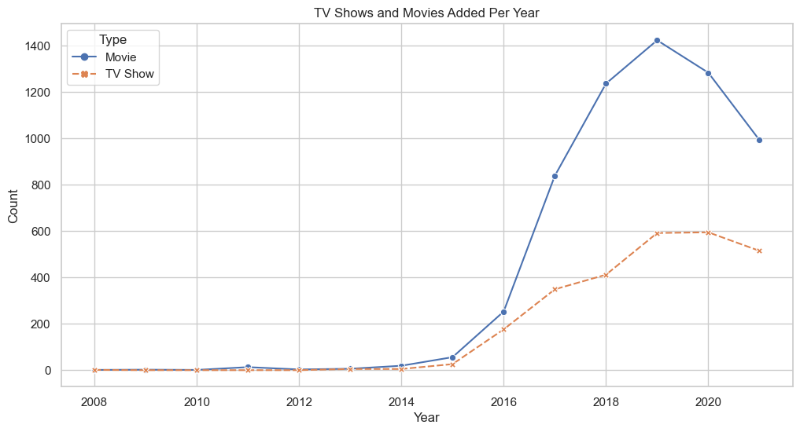
Decrease in the addition of new movies in 2020… covid reflex?
Netflix was released in 2007.
After 10 years later we have a considerable amount of series and movies added on its platform.
Notes:
The netflix platform released in 2007 and after 10 years we can see that there is a significant increase in content uploaded from their 2017 onwards, especially in the amount of movies uploaded. The decrease shown is most likely due to the Covid production pause and how it impacted the addition of new content on the platform. Tv shows show line show a slightly less decline compared to movies which suggests that customers may be shifting their bias towards tv shows over movies for the coming years.

Slide 17
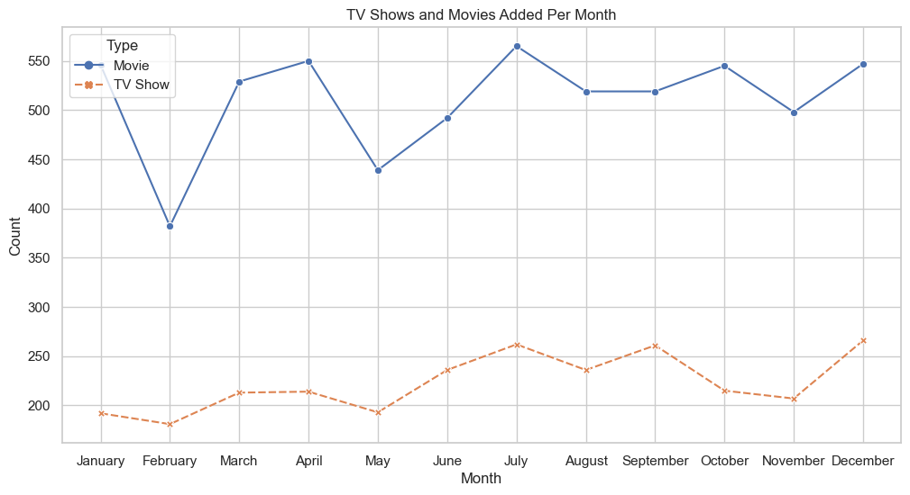
Notes:
This graph depicting the monthly addition of TV shows and movies. it suggests a correlation with seasonal breaks and increased content uploads to the platform, we can this with the months of january, april, july and december. This pattern implies that Netflix strategically targets these periods to meet the heightened demand for content, coinciding with higher user activity on the platform. Consequently, CS streaming services should consider prioritizing content additions during these specific times of the year to align with user behavior and maximize engagement. Futhermore, there are opportunities to capitalise on these heightened period by adding discounting or promotion to increase platform engagement.

Slide 18
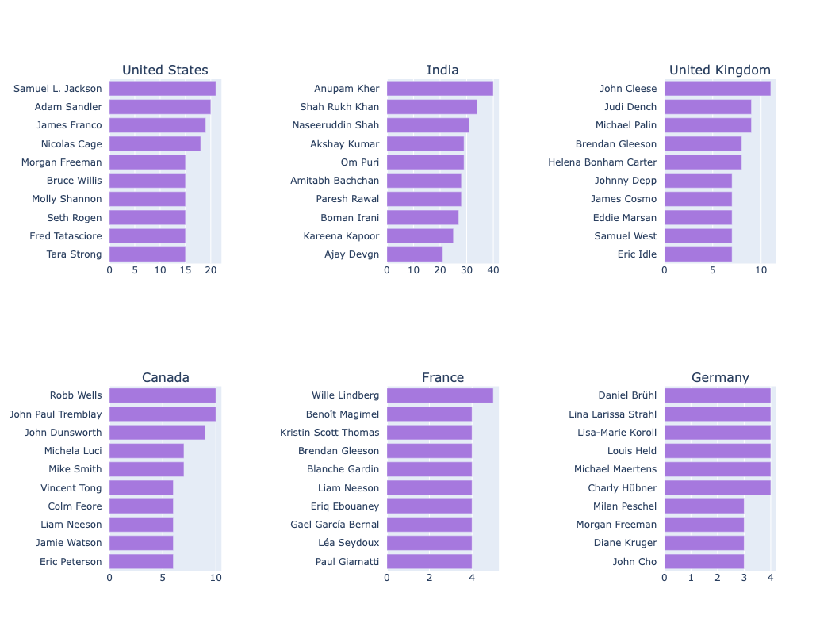
Actor Popularity Analysis - Movies
Cinema Icons: Most Featured Actors in Movies Worldwide
Notes:
Let's look at the actors from different countries and what they bring to the table for CS-Streaming. In the USA, we've got versatile actors like Samuel L. Jackson and Nicolas Cage, showing the strength of American movies. From India, there's Shah Rukh Khan and Amitabh Bachchan – big names in Bollywood, popular both at home and internationally. The UK brings us Judi Dench and Johnny Depp, actors known for a range of roles, from classic to modern films. Canada's Ryan Reynolds and Mike Myers are known for their roles in comedy and action movies. And from France and Germany, we see actors like Marion Cotillard and Daniel Brühl, who are part of a diverse European film scene.
This tells us that for CS-Streaming, picking movies with these well-known actors could be a smart move. They're popular around the world, and having their movies could help us draw in a wide audience and build a collection of internationally acclaimed films.

Slide 19
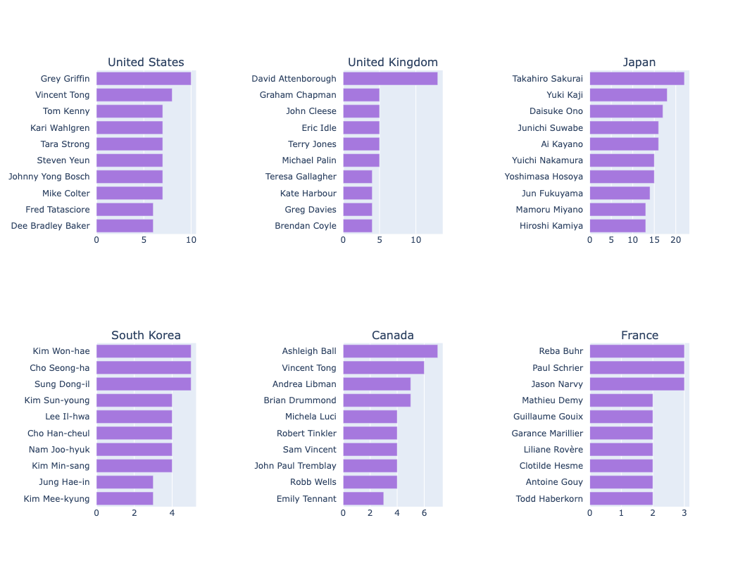
Actor Popularity Analysis - TV Shows
TV Stars on the Global Stage: Frequent Actors in Series
Notes:
In the TV show arena, the United States stands out with its strong lineup of voice actors, showing just how much people enjoy animated series. Over in the UK, the focus is on documentary and comedy, hinting at an audience that likes both learning and laughing. Japan's chart is filled with voice actors too, a nod to the worldwide popularity of anime. South Korea is making waves with its actors from hit K-dramas, showing their global reach. Canada, like the US, also has a notable presence of voice actors, pointing to the popularity of animation there. France's list is quite varied, suggesting a range of successful French shows with potential international appeal.
For CS-Streaming, this means there's a real opportunity in bringing in TV series with these actors, especially in genres like animation and drama. These shows and actors have fans all around the world, and that could really help us build a diverse, globally appealing TV lineup.

Slide 20
CS-Streaming Content Selection Decision Map
1. Is the movie/TV show produced in one of the top ten content-producing countries?
2. Does the movie/TV show belong to one of the top ten genres?
3. Based on the country of production, does the movie/TV show feature any of the top actors?
4. Was the movie/TV show released during the peak production era (2010-2018)?
5. Does the movie/TV show have a TV-MA or TV-14 rating?
6. For movies, is the duration around 80-120 minutes? For TV shows, does it have more than two seasons?
7. Is the content unique or not widely available on competing platforms?
8. Is the cost of acquiring the content justified by the potential return on investment?
Notes:
For our CS-Streaming Content Selection Decision Map, we have a straightforward yet effective approach. Let's walk through it:
We start by asking if the content is from one of the top ten content-producing countries. This ensures we're tapping into globally popular and high-quality productions.
Next, we check if it falls into one of the top genres. This aligns our offerings with viewer preferences and trends.
We then see if the content features any top actors based on the production country. Familiar faces can be a huge draw for our audience.
We look at the release period, focusing on the peak era of 2010 to 2018, to keep our library fresh and relevant.
The rating is important too. We're aiming for TV-MA or TV-14 to attract a mature audience.
For movies, we target the sweet spot of 80-120 minutes. For TV shows, we look for series with more than two seasons, indicating sustained viewer interest.
We assess if the content stands out from what's available on other platforms. This helps us offer a unique viewing experience.
Finally, we weigh the acquisition cost against potential returns, ensuring we make financially sound decisions.
Each step is crucial for curating a compelling and competitive library for CS-Streaming.

Slide 21
Conclusion and Way Forward for CS-Streaming
Leveraging Netflix's Data: Uncovered trends and preferences crucial for shaping CS-Streaming's content strategy.
Strategic Content Focus: Emphasis on top-producing countries, popular genres, and prominent actors to attract a broad audience.
Balanced Content Portfolio: A mix of recent hits and classic favorites to offer variety and depth.
Cost-Effective Content Acquisition: Each potential addition is evaluated for its audience appeal versus investment, ensuring a strategic approach to growth.
Notes:
In our final thoughts for CS-Streaming, let's recap what we've gathered from Netflix's invaluable data. It's given us a clear picture of what viewers are into these days – which countries are churning out hits, what genres are catching eyes, and which actors are drawing crowds. We're using these insights to carve out CS-Streaming's unique space in the streaming world.
Our strategy? It's all about hitting the right notes. We're not just throwing a wide net; we're being smart about it. We're zoning in on content from those buzzing hotspots, those genres that keep people talking, and movies and shows with faces everyone knows. And it's not just about what's hot right now; we're also bringing in those timeless classics that everyone loves to come back to.
But here's the key – every choice we make has to be smart, not just cool. We're looking at every movie, every show, and asking, 'Is this going to bring in the viewers? Is it worth the investment?' That's how we ensure CS-Streaming doesn't just grow, but grows smartly.
And, if we had more time and resources, We would dive even deeper. We would get viewer behaviour data, for example, explore more niche content areas, maybe even play around with predicting what the next big thing is going to be.
So this is the end of our presentation, thank you very much for your time and attention.

